Slide 1

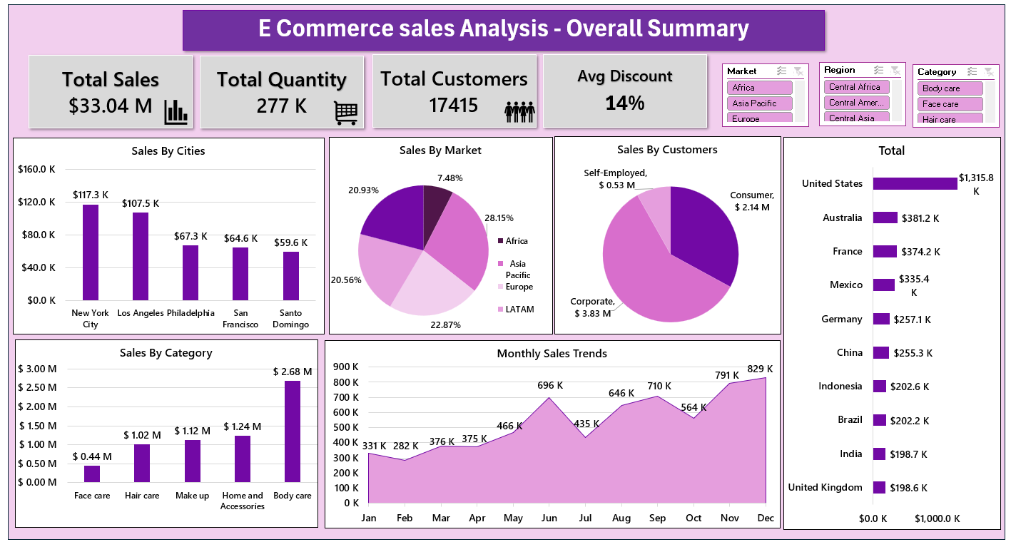
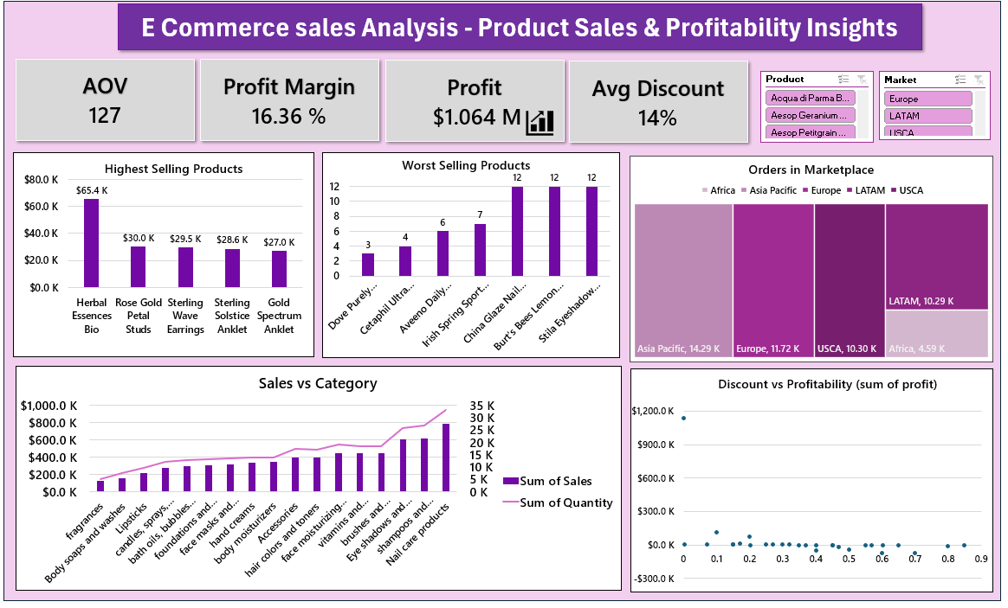
E-Commerce Sales Analysis
- Presented By
Neha Jade

Slide 2
Table of Content
Project Goals
Business Problem
Data Overview
Data Preparations
Analysis with Excel Formulae
Dashboard
Insights
Suggestions

Slide 3
Project Goal
Analyze e-commerce sales data across markets, regions, and product categories to understand business performance.
Uncover actionable insights related to customer behavior, sales trends, and profitability drivers.
Recommend strategic actions to boost revenue, improve profit margins, and strengthen market presence.
Business Problem Statement
Clear insights into sales performance across products, cities, and customer segments are currently missing.
There is limited understanding of how discounts affect overall profitability.
Data-driven insights are required to identify top-performing categories and regions.
A structured Excel-based analysis is essential to uncover key trends and support strategic decision-making.

Slide 4
Data Overview
The dataset contains e-commerce sales records, including details about orders, customers, products, and sales performance.
Column’s Descriptions:
Row ID: Unique record identifier.
Order ID: Unique order identifier.
Order Date: Date of purchase.
Customer ID: Unique customer identifier.
Segment: Customer type (Consumer, Corporate, Self-Employed).
City / State / Country: Location details of the order.
Region / Market: Broader geographical classification.
Category / Subcategory: Product categories (e.g., Hair Care, Make Up).
Product: Name of the product sold.
Quantity: Units sold.
Sales: Revenue from the sale.
Discount: Discount given.
Profit: Earnings from the sale.

Slide 5

Data Cleaning & Preparation
Prior to analysis, thorough data cleaning and preparation were conducted to ensure accuracy.
Remove Duplicate Entries
Identified and eliminated duplicate rows to ensure accurate analysis.
Removed Unwanted Column’s
Format Date Columns
Standardized date formats across all records (e.g., DD-MM-YYYY).
Validate Numeric Fields
Checked and corrected formatting for numeric fields:
  Sales
  Discount
  Profit
Ensured no missing or invalid numeric values.
➤ Remove Duplicate Entries
Identified and eliminated duplicate rows to ensure accurate analysis.
➤ Format Date Columns
Standardized date formats across all records (e.g., DD-MM-YYYY).

Slide 6
Business Problem & Key Questions
To support strategic decision-making, an analysis was conducted to identify sales performance trends, profitability drivers, and improvement areas. The following key business questions were formulated based on the dataset analysis.
What is the total sales revenue and profit?
What’s the average discount and its impact on profit?
What’s the average order value and customer spending?
Which products have the highest revenue?
Which products are low-selling, and what to do?
Which product category has the highest profit?
What is the total quantity sold and orders placed?
What’s the profit margin, and is it on target?
Which products/categories should be restocked?
Which products/categories are losing, and how to improve?

Slide 7




Data Analysis with Essential Excel Functions
1. Calculate the total sales, total profit, and average discount
Total Sales:
= SUM(Dataset!O2:O51189)
Total Quantities
= SUM(Dataset!N2:N51189)
Total Profit
= SUM(Dataset!Q2:Q51189)
Profit Margin %
= ( (D6/B6))
D6 = Total Profit, B6 = Total Sales

Slide 8


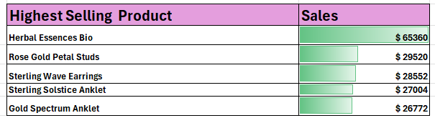
Avg Discount
= AVERAGE(Dataset!P2:P51189)
Avg Order Value
= B6/B13
B6 = Sale,B13 = orders
2. Find the highest-selling and lowest-selling products
Highest Selling Product
Product
= INDEX(I4:I3580, MATCH(LARGE(J4:J3580, ROW(A1)), J4:J3580, 0))
Sales
= LARGE(J:J, ROW(A1))

Slide 9
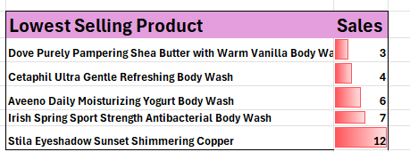
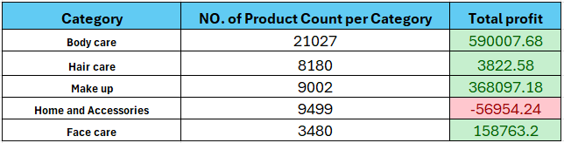
Lowest Selling Product
Product
= INDEX(I5:I3580, MATCH(SMALL(J5:J3580, ROW(A1)), J5:J3580, 0))
Total Sales
= SMALL(J5:J3580,ROW(A1))
Identify the most profitable product categories
Products per Categories
= COUNTIF(Dataset!L2:L51189, S3)
Total Profit
= SUMIF(Dataset!L2:L51189, S3, Dataset!Q2:Q51189)

Slide 10
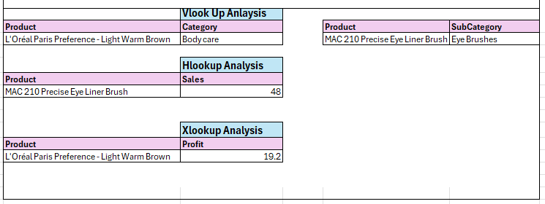
LookupAnalysis
Comparison of lookup functions used in Excel for data extraction
Look Up | Formulae | Output
VLOOKUP | =VLOOKUP(I4, A3:G51183,3,FALSE) | Body care
VLOOKUP | =VLOOKUP(L4,A3:G51183,2,FALSE) | Eye Brushes
HLOOKUP | =HLOOKUP("Sales",A2:G51118,3,FALSE) | 48 (Sales)
XLOOKUP | =XLOOKUP("L'Oréal Paris Preference - Light Warm Brown",A2:A51183,G2:G51183) | 19.2 (Profit)

Slide 11
Findings
Top-Selling Products
The product with the highest sales was Herbal Essences Bio generating $65,360.
Other high performers included Rose Gold Petal Studs and Sterling Wave Earrings.
Lowest-Selling Products
The product with the lowest sales was Dove Purely Pampering Shea Butter with Warm Vanilla Body Wash, with only 3 units sold.
Other low performers included Cetaphil Ultra Gentle Refreshing Body Wash and Aveeno Daily Moisturizing Body Wash.
Most Profitable Product Categories
Body Care was the most profitable category, earning $590,007.68 in total profit.
Face Care and Makeup also performed well, contributing significantly to overall profitability.
Loss-Making Category
Home and Accessories recorded a loss of $56,594.24, indicating a need for review or strategic changes.
Recommendations
Focus marketing efforts on high-performing products and categories.
Review pricing or product strategies for low-selling and loss-making items.
Maintain discounting strategy to keep a balance between volume and profitability.

Slide 12
Dashboard Overview
Provides a comprehensive analysis of e-commerce business performance.
Key metrics include total sales, customer count, quantity sold, and profit margins.
Top-performing cities and product categories are highlighted to identify key growth areas.
Monthly sales trends are visualized to track performance over time.
Identifies highest and lowest selling products for optimization opportunities.
Orders from different markets (regions) were analyzed to gain insights into market-wise performance
Discounts and profitability are analyzed to understand the impact of promotions on margins.

Slide 14
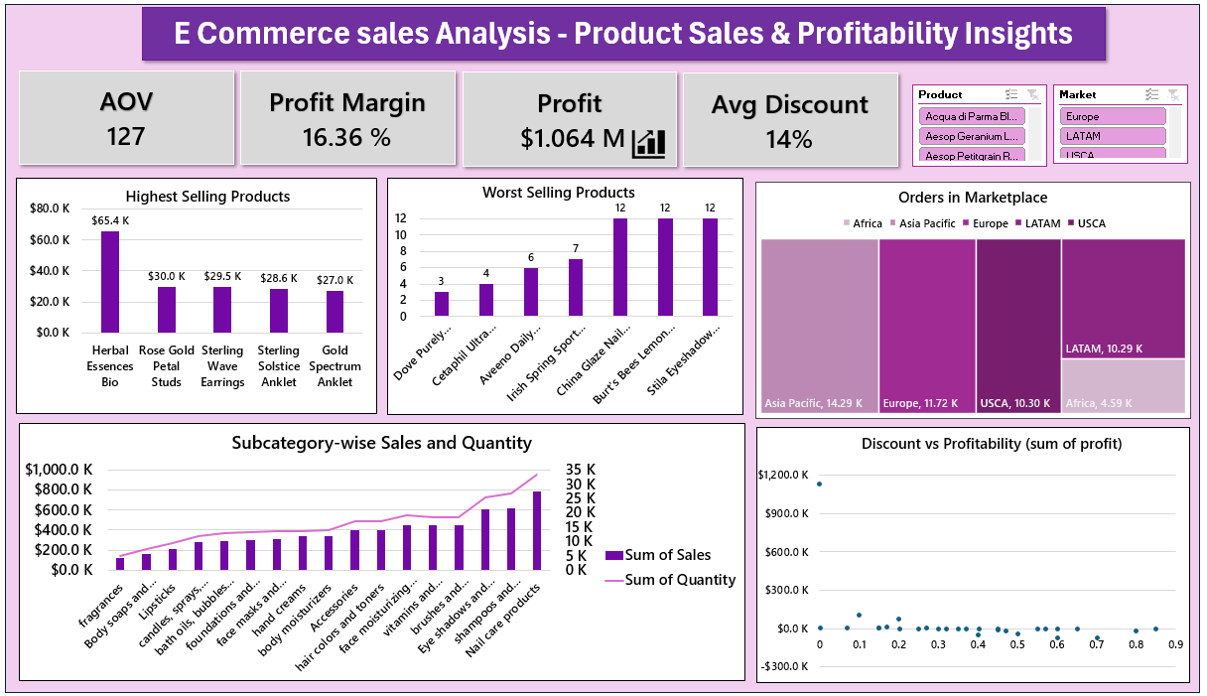

Slide 15

Data-Driven Observations
Key Insights from Dashboard 1: General Performance & Market Overview
Total Sales amount to $33.04M with 277K units sold and 17,415 customers served.
Top Cities by Sales: New York City ($117.3K) and Los Angeles ($107.5K) lead in sales.
Market Share by Region: Africa (28.15%) holds the largest market share, followed by LATAM (22.87%) and Europe (20.56%).
Customer Segments: Corporate customers contribute the highest revenue ($3.83M), while Consumers account for $2.14M.
Top-Selling Category: Body Care products dominate with $2.68M, far ahead of others.
Sales Trends: December shows the highest monthly sales ($829K), indicating a possible holiday season boost.
Country-Wise Sales: United States is the top market ($1.3M+) followed by Australia and France

Slide 16
Key Insights from Dashboard 2: Product Performance & Profitability
Profit Overview: Total profit is $1.064M with a 16.36% margin and an average order value (AOV) of $127.
Top 5 Best-Selling Products: Herbal Essences Bio leads with $65.4K in sales.
Top 5 Worst-Selling Products: Items like Stile Eyeshadow and Burt’s Bees Lemon show very low sales (~$12).
Orders by Marketplace: Asia Pacific and USCA have the highest number of orders (~10K+ each).
Discount vs Profitability: Minimal correlation is seen—higher discounts do not consistently drive higher profits.

Slide 17

Strategic Recommendations for Growth
Scale High-Performing Market
  Increase inventory and promotions in Africa, LATAM, and US cities like NYC and LA.
  Expand partnerships with retailers in top regions.
Revamp or Phase Out Low-Selling Products
  Review poor performers (e.g., Stila Eyeshadow, Burt’s Bees Lemon) for delisting or repositioning.
  Focus R&D on expanding best-performing lines like shampoos and body care.
Segment-Based Targeting
  Design loyalty programs and bundles tailored to Corporate buyers.
  Run targeted campaigns to uplift Consumer and Home Office segments.
Seasonal Promotion Planning
  Capitalize on Q4 peak sales with pre-planned campaigns from October onwards.
  Launch holiday bundles and limited editions.
Optimize Discounting Strategy
  Avoid blanket discounts; test with A/B pricing.
  Promote value-based pricing and loyalty rewards to improve profit margins.

Slide 18
Automation for Summary Report
Using Excel VBA, this project automates the creation of a one-page E-Commerce MIS Report, enabling quick Daily, Weekly, and Monthly performance insights with a single click.
What the Report Includes
Sales Overview: Total Sales, Quantity, Customers, Avg. Discount
Market Performance: Top Markets, Top Cities, Customer Segments
Product Performance: Profit, Profit Margin, AOV, Top & Worst-Selling Products, Top Categories
Key Benefits
One-click Daily / Weekly / Monthly report buttons
Clean, formatted output (no raw data shown)
Consistent layout, reduced manual effort
Works for any dataset via dynamic calculations
Link 🔗
View VBA Script

